Slide 1
ENGR 4220/5220: Control Systems
Rick Hill, PhD
Dept of Mechanical Engineering

Slide 2
Lecture 1: Overview and Intro
Introduction to the control system design process
Control system example
open loop vs. closed loop
Introduction to modeling
Solving differential equations
Free response
Forced response

Slide 3
Control System Design Process
customer
input / gov’t
regulations
eng specs
physical
system
diagrams
math
behavior
control
system
Plant
Design (and
Construction)
Translate
Model
Analyze
Controller Design
types of models
physical vs.
empirical
mathematical
graphical
purpose of models
analysis
design
verification
types of analysis
time domain
frequency domain
simulation
hardware in the
loop (HIL)
types of control
supervisory
logic control
on/off control
P, PI, PD, PID
advanced
techniques

Slide 4
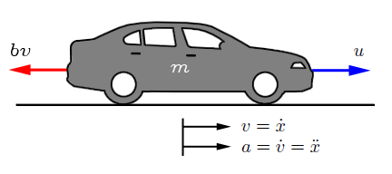
Control System Example
Cruise Control Example
Control
Algorithm
Engine
Car
desired
speed
throttle
angle
(voltage)
actual
speed
force

Slide 5
Open-loop Control [feedforward]
disadvantages
sensitive to errors
in model
sensitive to
disturbances
needs periodic
recalibration
advantages
simple to design
inexpensive
doesn’t affect
stability
fast response
wind force,
gravity force
Control
Algorithm
Engine
-
Car
desired
speed
throttle
angle
(voltage)
+
actual
speed
force

Slide 6
Closed-loop Control [feedback]
disadvantages
extra complexity
extra cost
can affect stability
can be slow to
respond
advantages
robust to errors
in model
robust to
disturbances
D
wind force,
gravity force
CONTROLLER
ACTUATOR
PLANT
R
+
E
-
U
Y
Control
Algorithm
Engine
Car
desired
speed
-
throttle
angle
(voltage)
+
actual
speed
force
SENSOR
Speedometer
measured
speed

Slide 7
Introduction to Modeling
A model is an abstraction of the physical world
Used for analysis and design, possibly before physical system exists
Can be obtained from first principles or experimentally
Purpose determines level of abstraction, form
Complex enough, but no more

Slide 8
Model Derivation
From first principles
Use physical laws to derive models
Provides understanding
Can use empirical data to determine parameters, validate model

Slide 9
Model Derivation
From empirical data
Feed a known input and observe output, fit model to data
Good for complicated systems (IC engine, battery)
Good for black-box systems (driver model)
Does not provide intuition, can’t be widely applied
SYSTEM

Slide 10
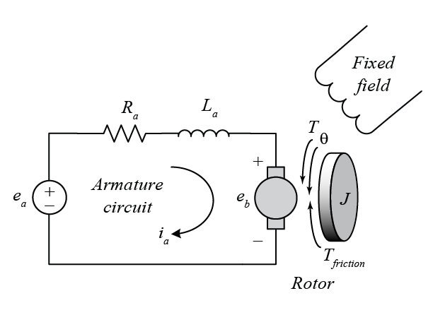
Complexity Depends on Purpose
Design/analysis model: simpler
Simple enough to generate closed-form solution
Less accurate, but provides intuition

Slide 11
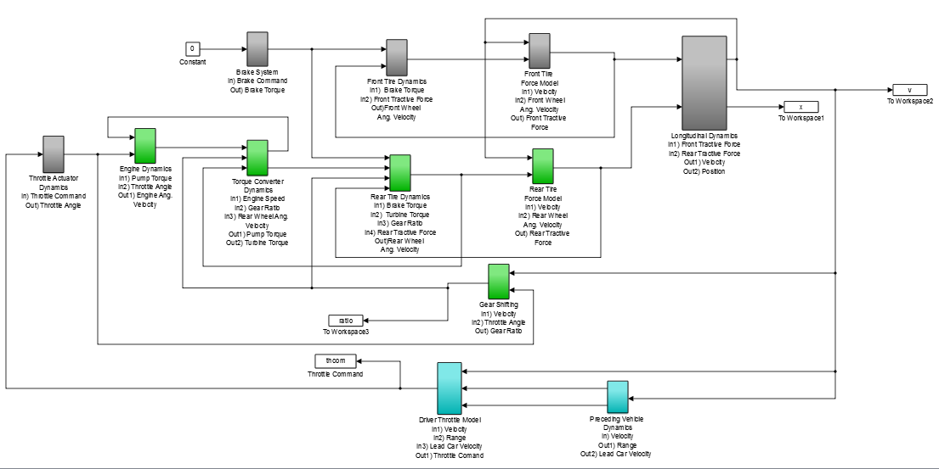
Complexity Depends on Purpose
Simulation model: more accurate

Slide 12
Static vs. Dynamic Systems
Static Systems
Dynamic Systems
Output is determined only by the current input, reacts instantaneously
Relationship does not change (it is static!)
Relationship is represented by an algebraic equation
Output takes time to react
Relationship changes with time, depends on past inputs and initial conditions (it is dynamic!)
Relationship is represented by a differential equation
input
SYSTEM
output

Slide 13
Static vs. Dynamic Systems
Motor from a Static Viewpoint
Motor from a Dynamic Viewpoint
T
T_{stall}
torque
e_{a1}
e_{a2}
ω
ω_{no-load}
speed

Slide 14
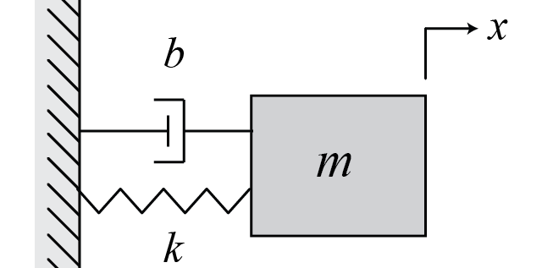
Solving Differential Equations
Homogenous differential equations
Righthand side of equation equals 0
Represents free response of system
Solution consists of exponentials
where exponents are roots of the characteristic eq.

Slide 15
Solving Differential Equations
Homogenous differential equations
For the above, the characteristic equation is
Roots can be found from the quadratic formula

Slide 16
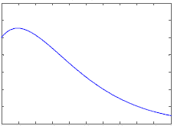
Solving Differential Equations
Recalling that
If the roots are completely real, then the solution is exponential
If all negative, stable
If any positive, unstable
displacement, x
time

Slide 17
Solving Differential Equations
If the roots are complex, then can rewrite in sines and cosines using Euler’s identity:
Therefore,

Slide 18
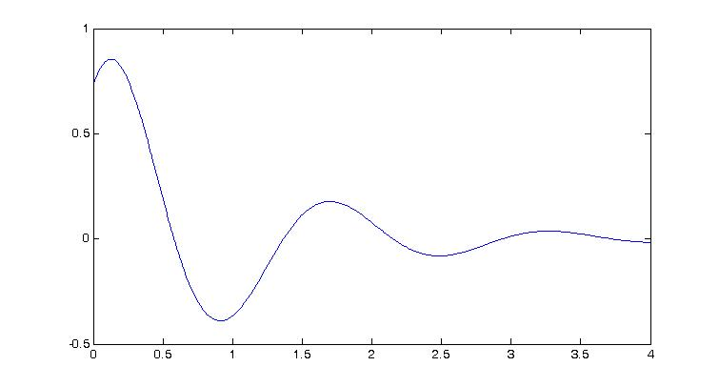
Solving Differential Equations
Above follows when have complex roots of char. eq.
real part = rate of decay (growth)
imag part = freq of oscillation

Slide 19
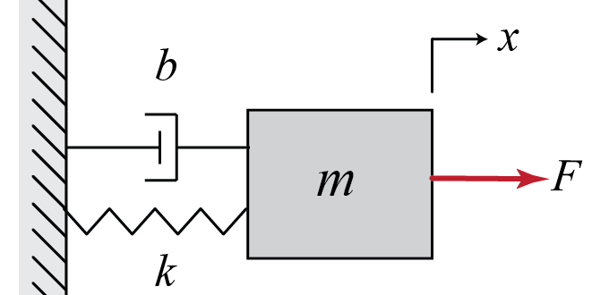
Solving Differential Equations
Forced differential equations
Solution consists of two parts
x_{h} is the homogenous solution
- same form as before, natural response of system
x_{p} is the particular solution
- generally same form as F(t), due to the input

Slide 20
Example
has a solution of the form
where
the homogenous portion dies out (transient)
the particular portion remains (steady state)
x_{h}(t)
x_{p}(t)

Slide 21
Example
Consider other types of forcing functions:

Slide 22
Example
Find the solution x(t) for

Slide 23
Example
Find the solution x(t) for

Slide 24
Example (continued)

